Slide 1

PROJECT Demo
of
Smart Agriculture system

Slide 2
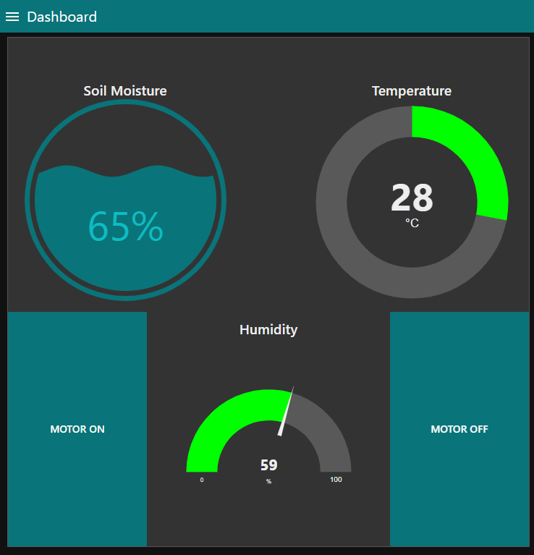
DASHBOARD
This is the main page of the whole application. This page displays the main dashboard where all the current reading (humidity, temperature and soil moisture) is transmitted. All this reading is shown in the gauge format. The readings are also in different colours, this help in the further visual display whenever the current reading goes out of range.
Furthermore, there is also the motor control on this main dashboard too, so whenever the reading goes beyond the required parameter it could be brought back in the ideal zone by turning the water motor on or off.

Slide 3
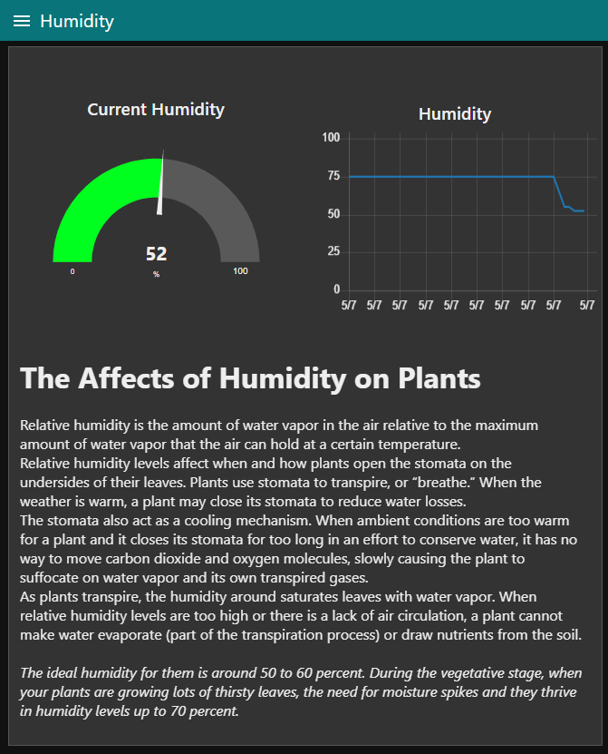
HUMIDITY
This is the page which shows the current and all the past changes in the humidity. Here the farmer or the gardener can track down the change in the humidity of the area around where the plant is planted. This can help him/her in predicting the future changes and thus can help them in taking the necessary steps to overcome such changes.
These tracking of the humidity is done in two formats. First is the gauge format, which shows the current humidity of the area. While the second is in the form of line chart which shows the changes in the humidity over time.
Also, this page shows some article about humidity. Like what is the appropriate amount of humidity that should be for a specific type of plant.

Slide 4
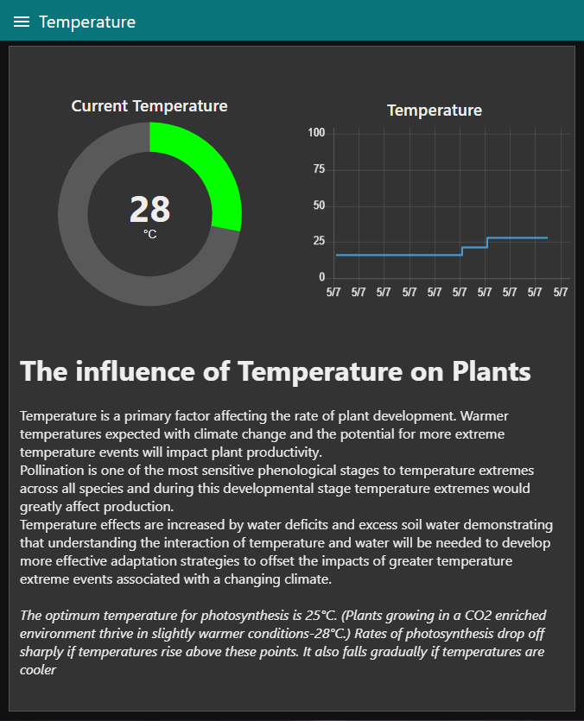
TEMPERATURE
This is the page which shows the current and all the past changes in the temperature. Here the farmer or the gardener can track down the change in the temperature of the area around where the plant is planted. This can help him/her in predicting the future changes and thus can help them in taking the necessary steps to overcome such changes.
These tracking of the humidity is done in two formats. First is the gauge format, which shows the current temperature of the area. While the second is in the form of line chart which shows the changes in the temperature over time.
Also, this page shows some article about temperature. Like what is the appropriate amount of temperature that should be for a specific type of plant.

Slide 5
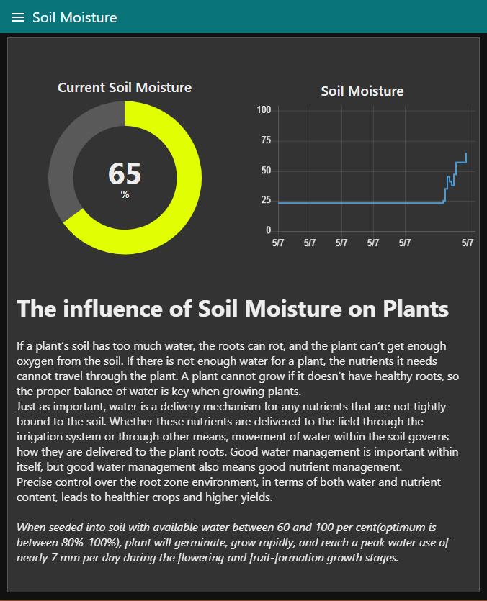
SOIL MOISTURE
This is the page which shows the current and all the past changes in the soil moisture. Here the farmer or the gardener can track down the change in the moisture of the soil around where the plant is planted. This can help him/her in predicting the future changes and thus can help them in taking the necessary steps to overcome such changes.
These tracking of the soil moisture is done in two formats. First is the gauge format, which shows the current moisture content of the area. While the second is in the form of line chart which shows the changes in the moisture over time.
Also, this page shows some article about soil moisture. Like what is the appropriate amount of moisture level for a specific type of plant.

Slide 6
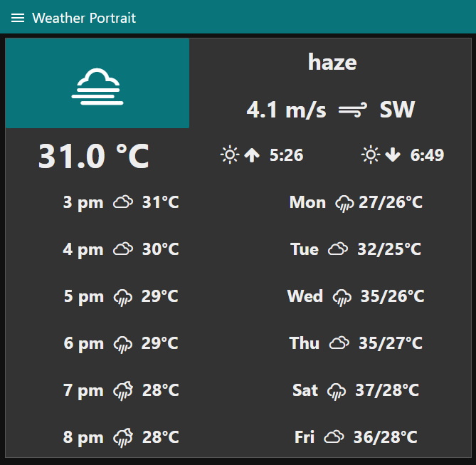
WEATHER AND FORECAST
This is the page which shows the current weather and the forecast so that the farmer or the gardener can take the necessary steps and thus regulated the water supply and also check the plant status every sunrise or sunset.
This flow shows the current description of the weather along with an icon showing the weather condition along with current temperature. Further, this also shows the wind speed and the direction of the wind. Next it gives the forecast for the next six hours and the next six days which could be really good for a farmer or gardener.
The icon that shows the current weather condition also works as a refresh switch that refreshes the prediction.
Overall, this part could be a great asset to the professional farmer or even to an amateur gardener.

Slide 7
THANK YOU
FOR YOUR ATTENTION
CONTACT INFO:
rachitup1004@gmail.com

